Slide 1
ActiveData
http://activedata.allizom.org
  Kyle Lahnakoski
  Engineering Productivity

Slide 2

Another lightning talk on…
ActiveData
http://activedata.allizom.org
  Kyle Lahnakoski
  Engineering Productivity

Slide 3
What is ActiveData?
A public web service…
$ curl http://activedata.allizom.org/query
-X POST
-d '{"from":"unittest"}'

Slide 4
What is ActiveData?
A public web service…
providing a query interface…
{
"select":{
"aggregate":"count"
},
"from":"unittest"
}

Slide 5
What is ActiveData?
A public web service…
providing a query interface…
to many billions of records…
{
"meta": {
"timing":{"total":1.77},
"saved_as":"3iK9T6sG",
"content_type":"application/json",
"format":"cube"
},
"data":{"count":2713971934}
}

Slide 6
What is ActiveData?
A public web service…
providing a query interface…
to over a billion test results…
Quickly!
{
"meta": {
"timing":{"total":1.77},
"saved_as":"3iK9T6sG",
"content_type":"application/json",
"format":"cube"
},
"data":{"count":2713971934}
}

Slide 7


What Data?
Buildbot
Jobs
ActiveData
Including Builder and MozHarness timings

Slide 8
What Data?
Buildbot
Jobs*
Test Results
ActiveData
All tests emitting structured logs

Slide 9

What Data?
Buildbot
Jobs
Test Results
Tasks
TaskCluster
ActiveData
Including `taskcluster` steps and MozHarness timings

Slide 10
What Data?
Buildbot
Jobs
Test Results
Tasks*
Test Results
TaskCluster
ActiveData
All tests emitting structured logs

Slide 11

What Data?
Buildbot
Jobs
Test Results
Tasks
Test Results
TaskCluster
Jobs
Treeherder
ActiveData
COMING SOON!

Slide 12

What Data?
Buildbot
Jobs
Test Results
Tasks
Test Results
TaskCluster
Jobs
Treeherder
perf details
ActiveData
Perfherder

Slide 13

What Data?
Buildbot
Jobs
Test Results
Tasks
Test Results
TaskCluster
Jobs
Treeherder
perf details
ActiveData
changesets
Perfherder
hg.mozilla.org

Slide 14

What Data?
Buildbot
Jobs
Test Results
Tasks
Test Results
TaskCluster
Jobs
Treeherder
perf details
ActiveData
changesets
Perfherder
Oranges
hg.mozilla.org

Slide 15
What Data?
Buildbot
Jobs
Test Results
Tasks
Test Results
Coverage
TaskCluster
Jobs
Treeherder
perf details
ActiveData
changesets
Perfherder
Oranges
hg.mozilla.org

Slide 16
What Data?
Buildbot
Jobs
Test Results
Tasks
Test Results
Coverage
TaskCluster
Jobs
Treeherder
perf details
ActiveData
changesets
Perfherder
Oranges
hg.mozilla.org

Slide 17
Why ActiveData?
Reduces query load on OLTP servers
Optimized for search and aggregation
Pool machine resources for these tasks
ActiveData is more discoverable than static data
Use 3rd party Dashboards, BI tools (like Redash), Python notebooks

Slide 18
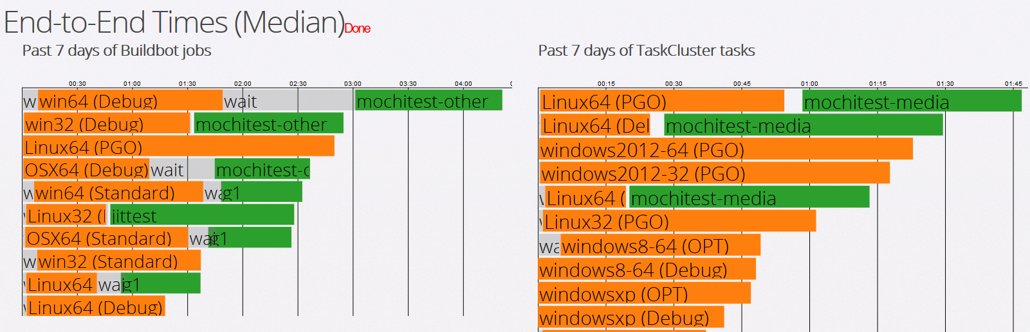
Dashboards
https://people-mozilla.org/~klahnakoski/MoBuildbotTimings/End-to-End.html

Slide 19
Dashboards
Long running test
https://people-mozilla.org/~klahnakoski/MoBuildbotTimings/End-to-End.html

Slide 20
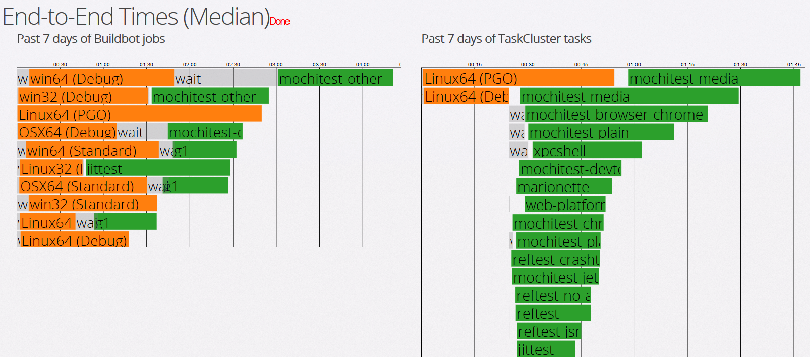
Dashboards
https://people-mozilla.org/~klahnakoski/MoBuildbotTimings/End-to-End.html

Slide 21
Dashboards
All the others
https://people-mozilla.org/~klahnakoski/MoBuildbotTimings/End-to-End.html

Slide 22
Dashboards
Click to get details
https://people-mozilla.org/~klahnakoski/MoBuildbotTimings/End-to-End.html

Slide 23
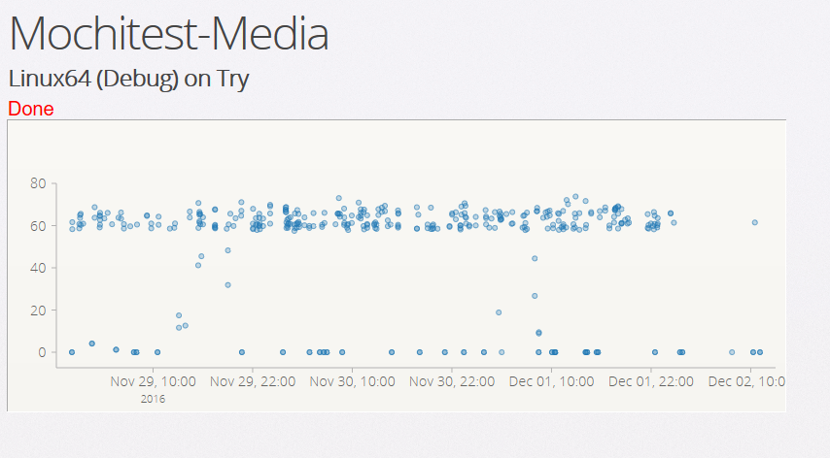
Dashboards

Slide 24
Dashboards
Lots of “deadline-exceeded”

Slide 25
Dashboards
Click to get details

Slide 26
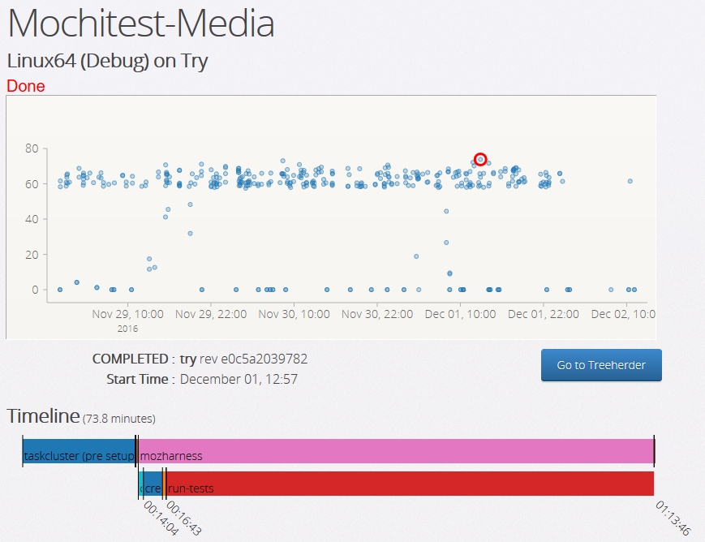
Dashboards

Slide 27
Dashboards
13min of TC setup

Slide 28
Dashboards
2min create-virtualenv

Slide 29
Dashboards
56min run-tests

Slide 30
Dashboards
Go to Treeherder to see the log

Slide 31
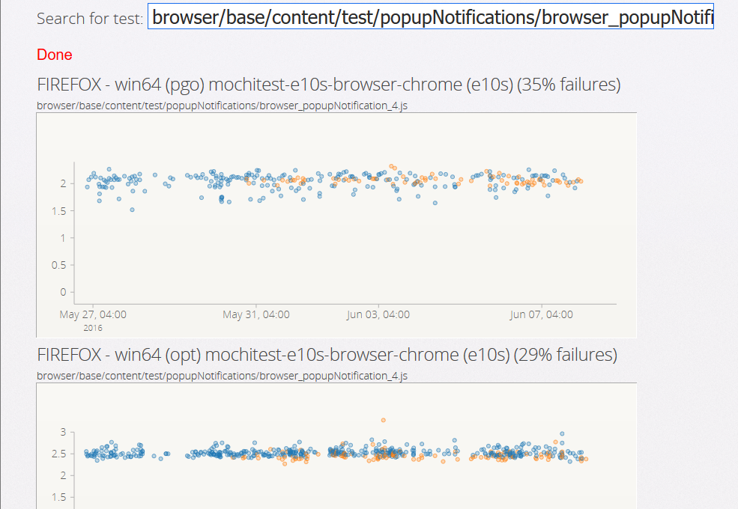
Dashboards
https://people-mozilla.org/~klahnakoski/testfailures

Slide 32
Dashboards
First occurrence in late May
https://people-mozilla.org/~klahnakoski/testfailures

Slide 33
Future Plans?
Attach Redash
Move to https://charts.mozilla.org
Work on SQL parser *
$ curl http://activedata.allizom.org/query
-X POST
-d '{"sql":"select count(1) from unittest"}'
*https://github.com/mozilla/moz-sql-parser

Slide 34
Active Data
Don’t use static files!
Use an Active Database!
  Kyle Lahnakoski
  Engineering Productivity

Slide 35
Active Data
http://activedata.allizom.org
  Kyle Lahnakoski
  Engineering Productivity

